Slide 1
Flip-Flops
Reference: Chapter 5
Sequential Circuits
Moris Mano 4th Ediditon

Slide 2
Revision

Slide 3
Types of Logic Circuits
Combinational Logic Circuits
Sequential Circuits

Slide 4
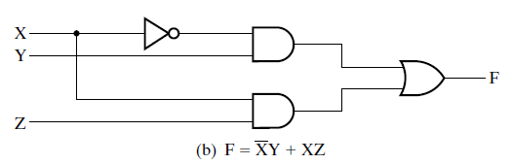
Combinational VS Sequential Circuits
Combinational Logic Circuits
In which variables are combined by the logical operations
Output depends on inputs and logic operations
Logic Diagram of a Combinational Circuit

Slide 5
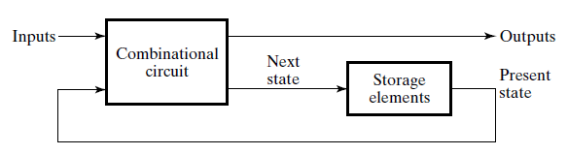
Combinational VS Sequential Circuits (contd.)
Sequential Circuits
Which include storage elements
Output depends on input and the value of storage element
Logic Diagram of a Sequential Circuit

Slide 6
Storage Element
Storage elements are circuits
that stores binary information for indefinite time
Can change their state(value stored) on the basis of input signal
Notes:
We need 1-bit or n-bit storage elements

Slide 7
Latches

Slide 8
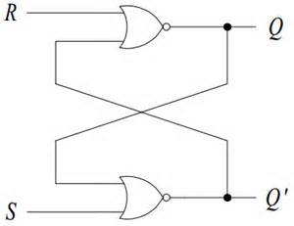
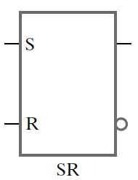
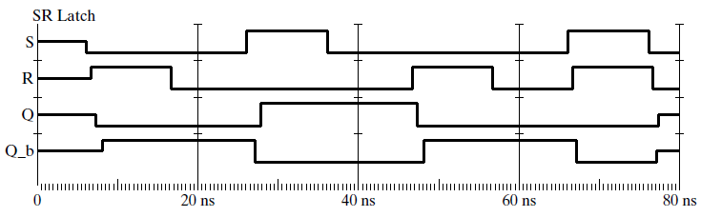
SR Latch
Logic Diagram
Function Table
Graphic Symbol
Input |  | Output |  | State
S | R | Q | Q’
1 | 0 | 1 | 0 | Set
0 | 0 | 1 | 0
0 | 1 | 0 | 1 | Reset
0 | 0 | 0 | 1
1 | 1 | 0 | 0 | Undefined
Q
Q’
Timing diagram / Logic Simulation of SR Latch

Slide 9
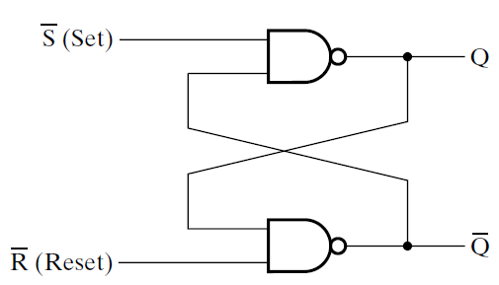
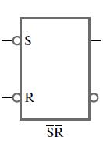
S’R’ Latch
Function Table
Logic Diagram
Input |  | Output |  | State
S’ | R’ | Q | Q’
0 | 1 | 1 | 0 | Set
1 | 1 | 1 | 0
1 | 0 | 0 | 1 | Reset
1 | 1 | 0 | 1
0 | 0 | 1 | 1 | Undefined
Q
Q’
Graphic Symbol

Slide 10
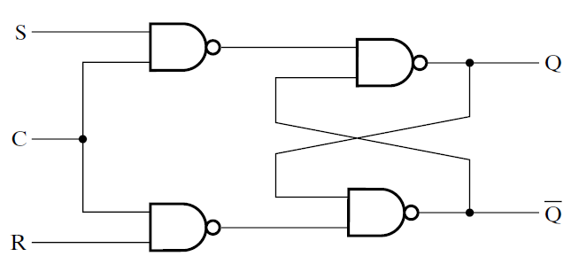
SR Latch with Control Input
Input
C | S | R | Next State Of Q
0 | X | X | No Change
1 | 0 | 0 | No Change
1 | 0 | 1 | Q=0, Reset
1 | 1 | 0 | Q=1, Set
1 | 1 | 1 | Undefined
Logic Diagram
Function Table

Slide 11
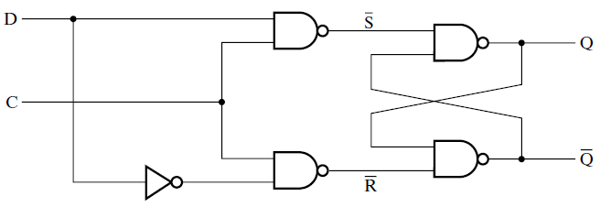
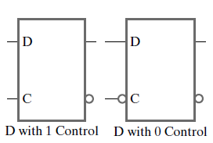
D Latch
Logic Diagram
C | D | Next State of Q
0 | X | No Change
1 | 0 | Q=0, Reset State
1 | 1 | Q = 1, Set State
Function Table
Timing Diagram of D Latch

Slide 12
Synchronization in Digital Systems
Timing Device – Clock Generator
Generates clock pulses
Positive Pulse Negative Pulse
Positive Edge Negative Edge

Slide 13
Synchronization in Digital Systems
Clock as control input of Latches
Problem with Latches
Transparency
Solution → Flip-Flops
Notes:
If control input = 1, 1000 changes in input signals result in 1000 changes at output of latch. This is what makes the latches transparent.

Slide 14
Flip-Flop

Slide 15
Types of Flip-Flops
Pulse-Triggered Flip-Flops
Edge-Triggered Flip-Flops

Slide 16
Pulse-Triggered Flip-Flop

Slide 17
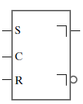
SR Master Slave Flip-Flop
Pulse Triggered SR Master-slave Flip Flop
Accepts input signals at
Positive Pulse
Updates the output at
Negative Pulse
Q
Q’
Graphic Symbol
Right angle means
Output signal
Changes at the end
Of the pulse

Slide 18
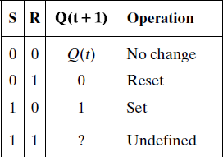
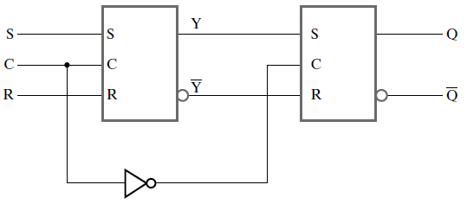
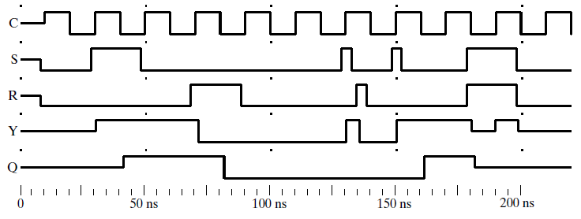
SR Master-Slave Flip-Flop
M
S
Characteristic Table
Logic Simulation of SR Master-Slave Flip-Flop

Slide 19
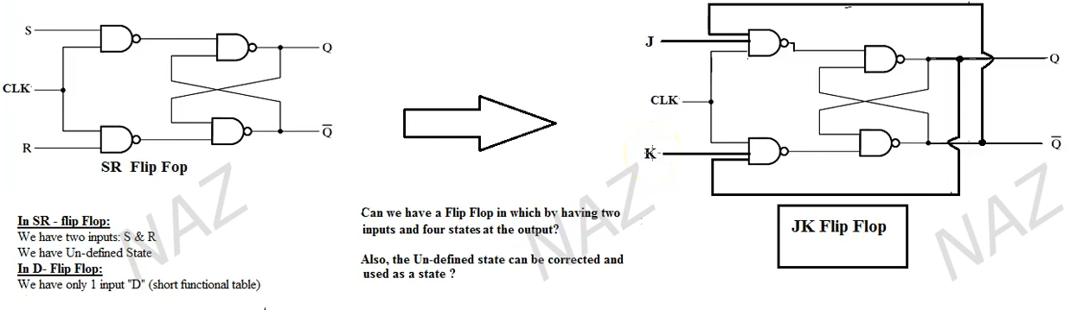
JK FF from SR FF

Slide 20
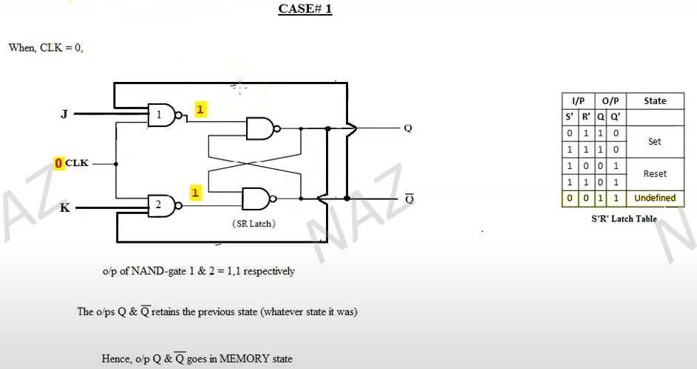
Any one of the inputs of NAND = 0 ➔ Output = 1

Slide 21
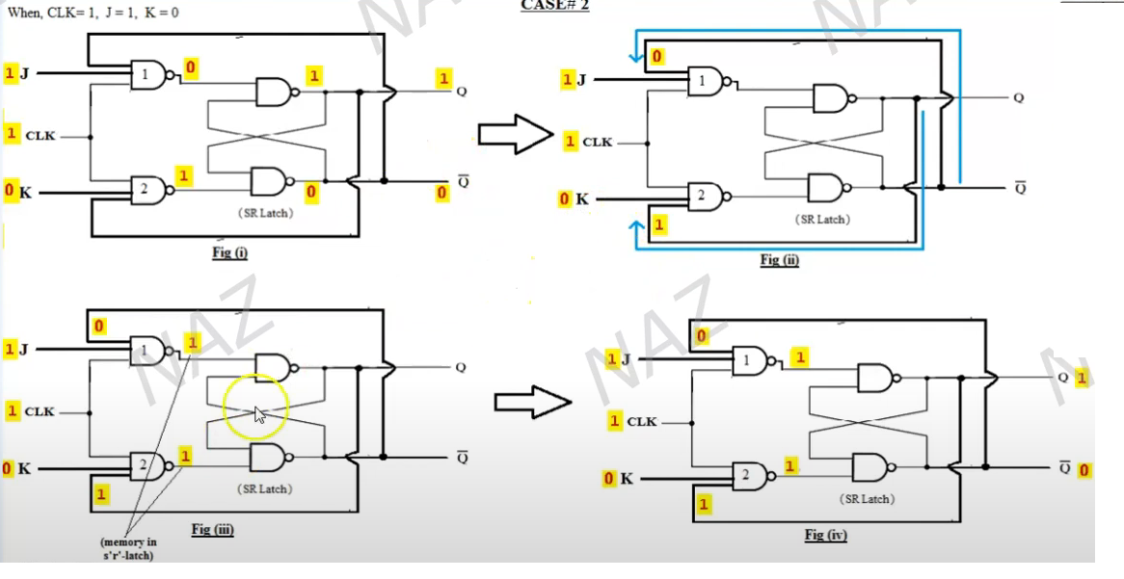

Slide 22
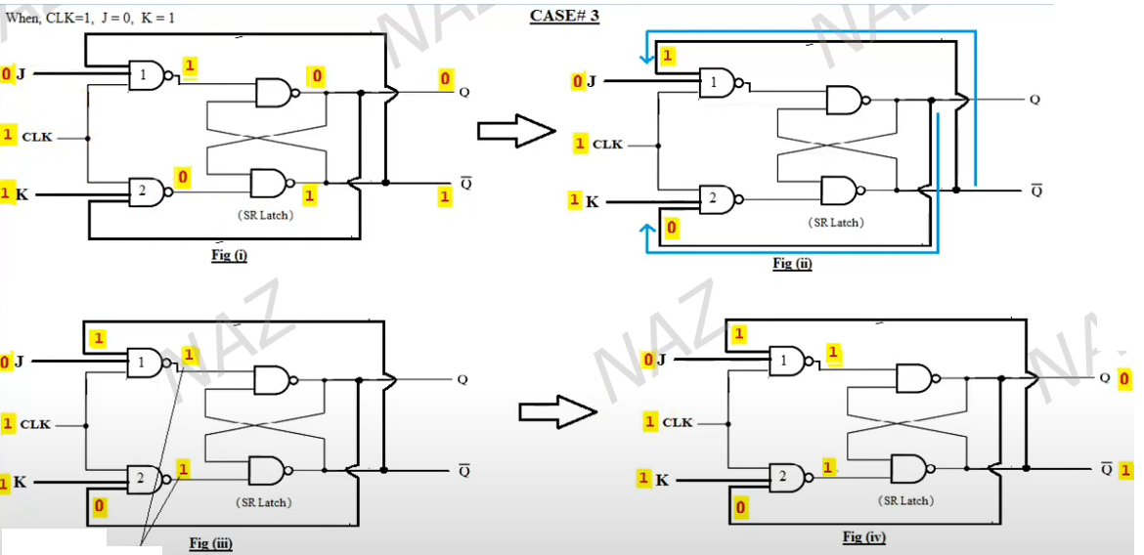
Memory

Slide 23
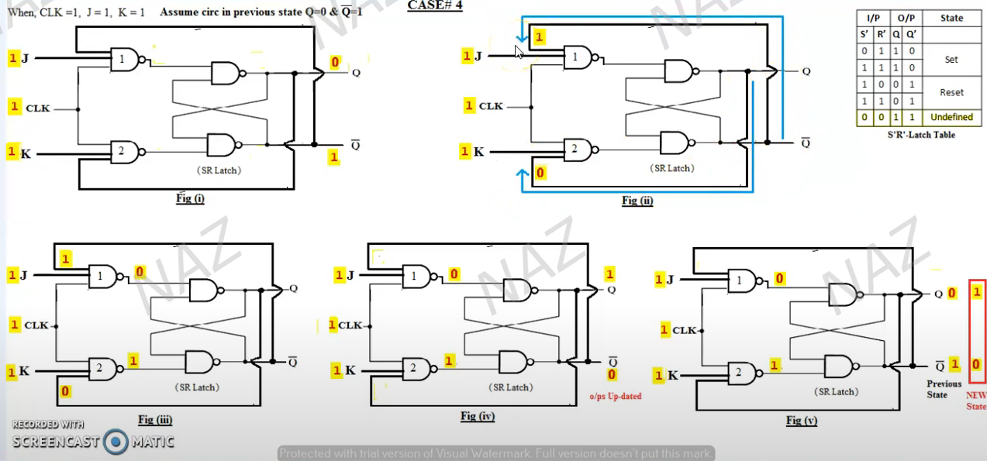

Slide 24
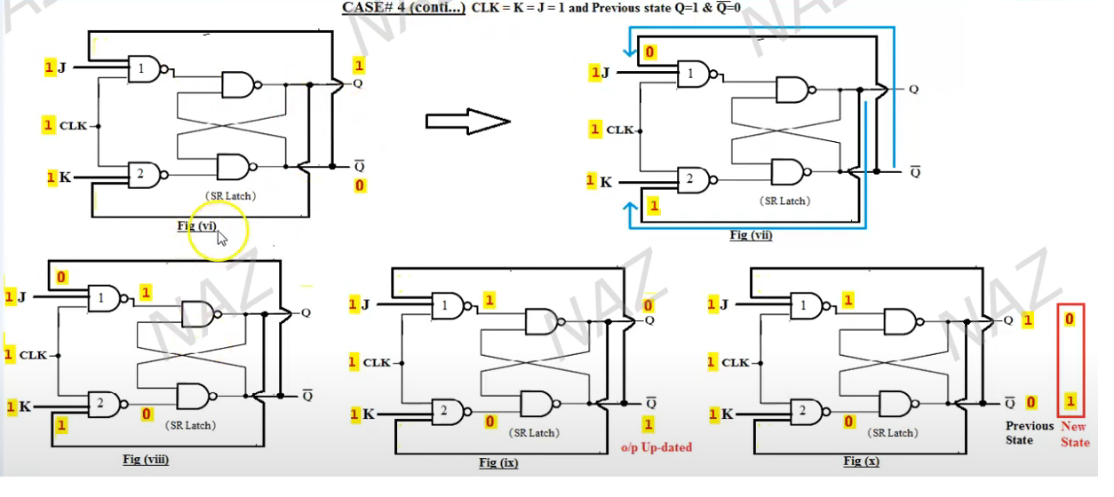

Slide 25
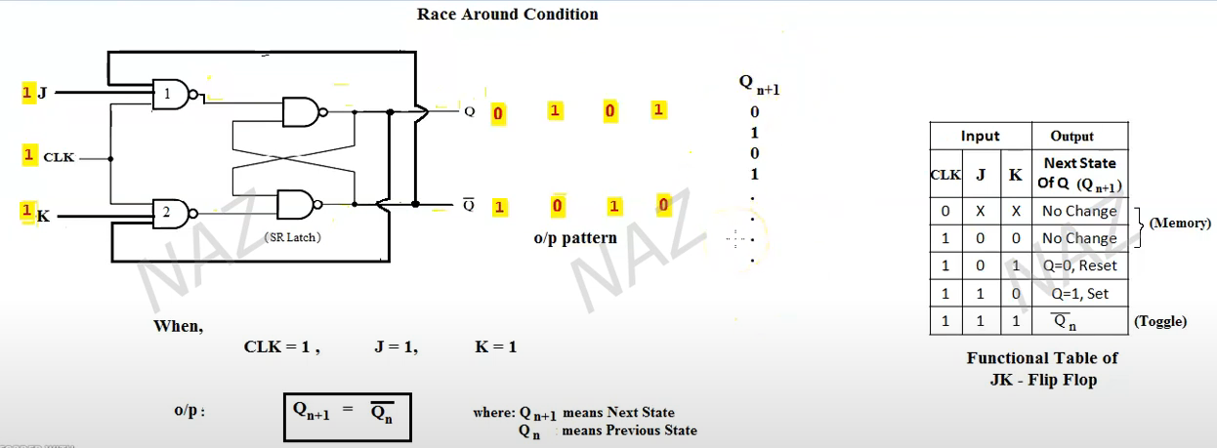
Race Around Condition

Slide 26
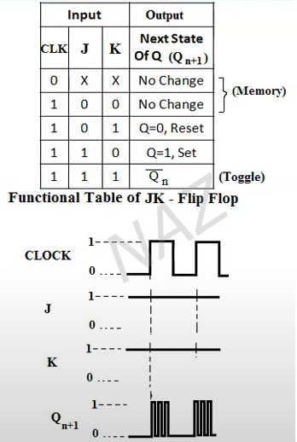
Race Around Condition

Slide 27
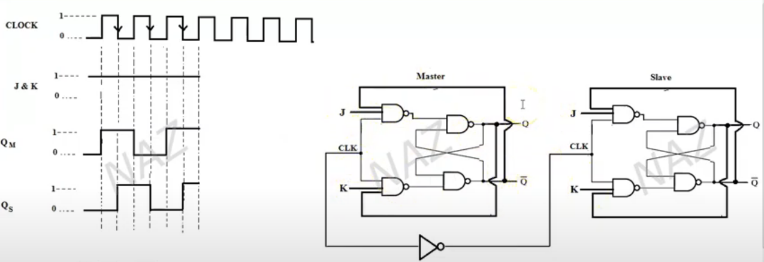
Toggling State in Master Slave JK FF
Q(n+1) = Qn
Toggle

Slide 28
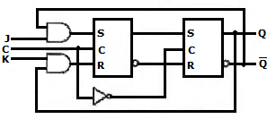
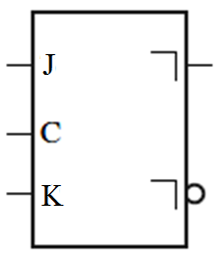
Master-Slave JK Flip-Flop
J | K | Q(t+1)
0 | 0 | Q(t)
0 | 1 | 0
1 | 0 | 1
1 | 1 | Q(t)’
Q
Q’
Characteristic Table
Graphic Symbol
Notes:
Modified version of SR Flip-Flop
Eliminates undesirable condition (1,1) → Undefined State

Slide 29
Master-Slave JK Flip-Flop
Characteristic Table
Input Signal = (1,1)
Case 1:
Previous State = (0,1)
J | K | Q(t+1)
0 | 0 | Q(t)
0 | 1 | 0
1 | 0 | 1
1 | 1 | Q(t)’
0
1
1
1
1
Notes:
At time t, Flip-flop had value 0 saved in it. Now signal (1,1) is coming at time t+1.

Slide 30
Master-Slave JK Flip-Flop
Characteristic Table
Input Signal = (1,1)
Case 1:
Previous State = (0,1)
J | K | Q(t+1)
0 | 0 | Q(t)
0 | 1 | 0
1 | 0 | 1
1 | 1 | Q(t)’
0
1
1
0
1
1

Slide 31
Master-Slave JK Flip-Flop
Characteristic Table
Input Signal = (1,1)
Case 1:
Previous State = (0,1)
J | K | Q(t+1)
0 | 0 | Q(t)
0 | 1 | 0
1 | 0 | 1
1 | 1 | Q(t)’
1
0
1
1
0
1
1
0

Slide 32
Master-Slave JK Flip-Flop
Characteristic Table
Input Signal = (1,1)
Case 1:
Previous State = (0,1)
J | K | Q(t+1)
0 | 0 | Q(t)
0 | 1 | 0
1 | 0 | 1
1 | 1 | Q(t)’
Which means save 1
1
1
0
1
1
0
0
1
1
0

Slide 33
Master-Slave JK Flip-Flop
Characteristic Table
Input Signal = (1,1)
Case 1:
Previous State = (0,1)
J | K | Q(t+1)
0 | 0 | Q(t)
0 | 1 | 0
1 | 0 | 1
1 | 1 | Q(t)’
1
1
1
0
1
1
0
0
1
0
1
0

Slide 34
Master-Slave JK Flip-Flop
Characteristic Table
Input Signal = (1,1)
Case 1:
Previous State = (0,1)
J | K | Q(t+1)
0 | 0 | Q(t)
0 | 1 | 0
1 | 0 | 1
1 | 1 | Q(t)’
1
1
1
1
1
0
1
0
0
1
0
0

Slide 35
Master-Slave JK Flip-Flop
Characteristic Table
Input Signal = (1,1)
Case 2:
Previous State = (1,0)
J | K | Q(t+1)
0 | 0 | Q(t)
0 | 1 | 0
1 | 0 | 1
1 | 1 | Q(t)’
1
1
1
1
0
Notes:
At time t, Flip-flop had value 1 saved in it. Now signal (1,1) is coming at time t+1.

Slide 36
Master-Slave JK Flip-Flop
Characteristic Table
Input Signal = (1,1)
Case 2:
Previous State = (1,0)
J | K | Q(t+1)
0 | 0 | Q(t)
0 | 1 | 0
1 | 0 | 1
1 | 1 | Q(t)’
1
1
1
0
1
0

Slide 37
Master-Slave JK Flip-Flop
Characteristic Table
Input Signal = (1,1)
Case 2:
Previous State = (1,0)
J | K | Q(t+1)
0 | 0 | Q(t)
0 | 1 | 0
1 | 0 | 1
1 | 1 | Q(t)’
0
1
1
1
0
1
0
1

Slide 38
Master-Slave JK Flip-Flop
Characteristic Table
Input Signal = (1,1)
Case 2:
Previous State = (1,0)
J | K | Q(t+1)
0 | 0 | Q(t)
0 | 1 | 0
1 | 0 | 1
1 | 1 | Q(t)’
Which means save 0
0
0
1
1
1
0
1
1
0
1

Slide 39
Master-Slave JK Flip-Flop
Characteristic Table
Input Signal = (1,1)
Case 2:
Previous State = (1,0)
J | K | Q(t+1)
0 | 0 | Q(t)
0 | 1 | 0
1 | 0 | 1
1 | 1 | Q(t)’
0
0
0
1
1
1
0
1
1
1
0
1

Slide 40
Master-Slave JK Flip-Flop
Characteristic Table
Input Signal = (1,1)
Case 2:
Previous State = (1,0)
J | K | Q(t+1)
0 | 0 | Q(t)
0 | 1 | 0
1 | 0 | 1
1 | 1 | Q(t)’
0
0
0
1
0
0
1
1
1
1
1
1

Slide 41
Test Your Concepts
Can you fix the undefined state problem in SR and S’R’ latches?

Slide 42
Pulse-Triggered Flip-Flop vs Edge-Triggered Flip-Flop

Slide 43
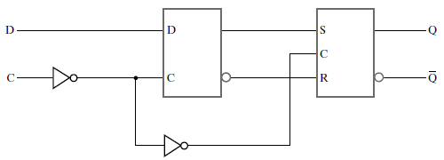

Positive-Edge-Triggered D Flip-Flop
Triggers on
Positive Edge
of Control signal
Q
D | Q(t+1) | Operation
0 | 0 | Reset
1 | 1 | Set
Q’
Characteristic Table
Graphic Symbol

Slide 44
Positive-Edge-Triggered D Flip-Flop
Dynamic
Indicator
Symbol
Q
D | Q(t+1) | Operation
0 | 0 | Reset
1 | 1 | Set
Q’
Characteristic Table
Graphic Symbol

Slide 45
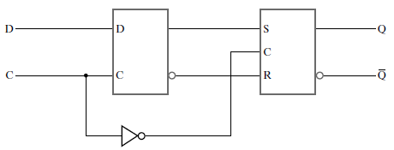
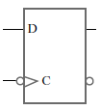
Negative-Edge-Triggered D Flip-Flop
Graphic Symbol
Triggers on Negative Edge of Control signal

Slide 46
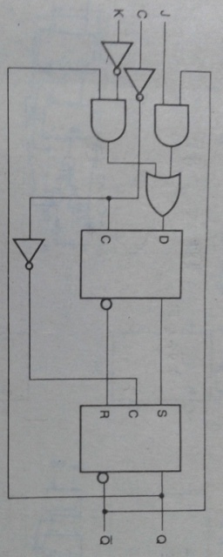
Positive-Edge-Triggered JK Flip-Flop

Slide 47
Equations of Flip-Flops

Slide 48
Equation of D Flip-Flop
D
D
Q(t+1) = D(t)

Slide 49
SR Latch with Control Input
Logic Diagram

Slide 50
SR Latch with Control Input
C = 1
Logic Diagram

Slide 51
SR Latch with Control Input
S’
C = 1
R’
Logic Diagram

Slide 52
SR Latch with Control Input
S’
C = 1
R’
(R’ Q(t) )’
Logic Diagram

Slide 53
SR Latch with Control Input
S’
(S’ (R’ Q(t) )’ )’
C = 1
R’
(R’ Q(t) )’
Logic Diagram

Slide 54
Equation of SR Flip-Flop
Q(t+1) = S(t) + R’(t)Q(t)
Q(t+1) is a function of input signals S and R at time t and Q(t)

Slide 55
Equation of Positive-Edge-Triggered JK Flip-Flop
Q(t+1) = J(t)Q’(t) + K’(t)Q(t)

